Slide 1
ADHCRI Health Intelligence Dashboard: Data-Driven Insights for ASEAN Public Health Resilience
SDG 3
Good Health & Well-being
SDG 10
Reduced Inequalities
SDG 17
Partnerships for the Goals
Contributors
Temilade Momoh
Mariam Adetoyi
Chioma Nwosu
Olarenwaju Adekoya
Healthsync Analytics Team
Our Slogan: Data Analytics Focus
10Alytics Global Hackathon 2026

Slide 2
The Challenge
10Alytics Global Hackathon 2026
ASEAN needs faster, clearer public health intelligence to support resilient decision-making.
Core problem
Fragmented health data, unequal health investment, infectious disease burden, and climate-related health risks make it difficult to prioritise action across ASEAN countries.
01
Health inequality
Different levels of mortality, nutrition risk and life expectancy.
02
Disease burden
TB, malaria and HIV indicators require stronger monitoring.
03
System capacity
Workforce and expenditure vary across countries.
04
Decision gaps
Policy leaders need simple priority signals from data.
Data → Insight → Action
ADHCRI Health Intelligence Dashboard | 2

Slide 3
Analytics Objective
10Alytics Global Hackathon 2026
The dashboard is designed as a decision-support tool, not just a chart collection.
Main analytical question
Which ASEAN countries face the greatest public health risks, and where should policymakers prioritise investment to improve SDG 3 outcomes?
1
Identify health gaps
2
Understand risk drivers
3
Guide policy action
Compare country-level outcomes across mortality, disease, nutrition and life expectancy.
Connect child health, disease burden and system capacity indicators.
Translate evidence into investment and intervention priorities.
Project output: an interactive Power BI dashboard supported by a report and presentation.
ADHCRI Health Intelligence Dashboard | 3

Slide 4
Dataset Overview
10Alytics Global Hackathon 2026
Historical ASEAN public health indicators aligned to SDG 3, SDG 10 and SDG 17.
ASEAN countries
Indicators used
Valid records
Year coverage
10
16+
1,691
1990–2016
Indicator themes
Population Dynamics
Crude birth / death rates
Disease Burden
TB, malaria, HIV and HIV/AIDS deaths
Health Outcomes
Life expectancy
Nutrition & Food Security
Undernourished population and underweight children
Child & Maternal Health
Infant, under-5 and maternal mortality
System Capacity
Health expenditure and workforce density
Important limitation: the data is historical and should be interpreted as SDG trend analysis, not a live 2026 health surveillance system.
ADHCRI Health Intelligence Dashboard | 4

Slide 5
Power Query & Data Model
10Alytics Global Hackathon 2026
The raw files were standardised into a clean fact table and dimension model.
Cleaning workflow
1
Load raw CSV files
2
Standardise country names
3
Unpivot year columns
4
Add indicator names
5
Append into fact table
Star schema
Dim_Country
Country
Dim_Year
Year
Fact_Health_Indicators
Country • Year • Indicator • Value
Dim_Indicator
Indicator • Category • Unit
Why this matters: mixed units remain meaningful because each value is always interpreted within its indicator and unit context.
ADHCRI Health Intelligence Dashboard | 5

Slide 6
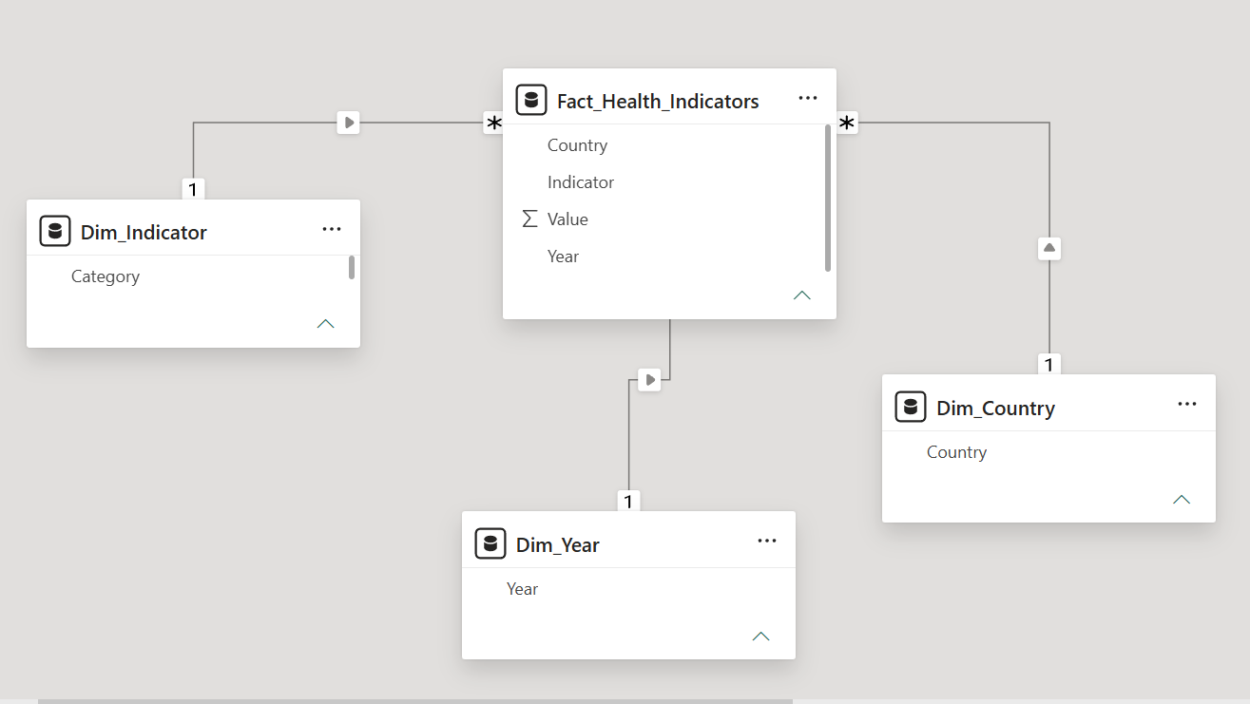

Slide 7
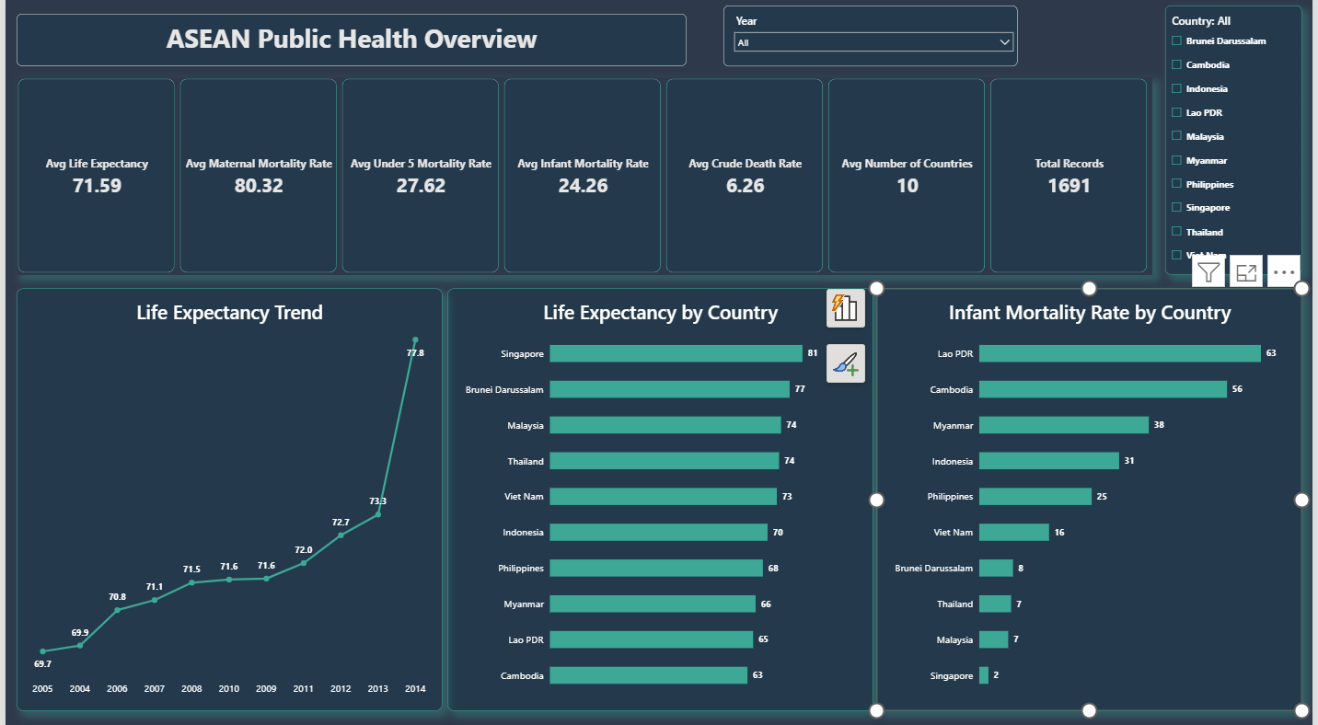
Dashboard Page 1: Public Health Overview
10Alytics Global Hackathon 2026
A high-level view of ASEAN health outcomes and mortality gaps.
What this page shows
• Life expectancy differences
• Infant and under-5 mortality
• Maternal mortality
• Crude death rate
• Country and year filtering
Key insight
Life expectancy differs across ASEAN countries, while child and maternal mortality indicators reveal clear public health outcome gaps.
Design note
Rates and percentages are analysed as averages within each selected indicator to avoid mixing incompatible units.
ADHCRI Health Intelligence Dashboard | 6

Slide 8
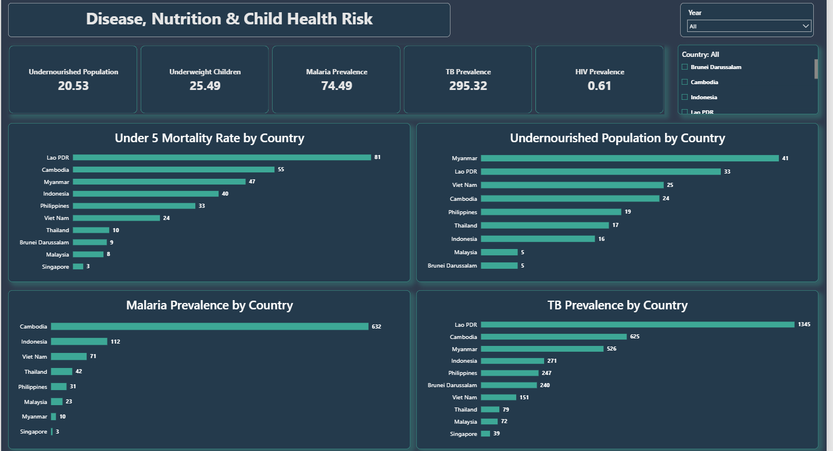
Dashboard Page 2: Health Risk
10Alytics Global Hackathon 2026
Disease, nutrition and child health indicators identify higher vulnerability across ASEAN countries.
Observed risk pattern
• Lao PDR leads under-5 mortality
• Myanmar and Lao PDR show high undernourishment
• Cambodia leads malaria prevalence
• Lao PDR leads TB prevalence
Policy meaning
Countries with overlapping child health, nutrition and disease burdens require targeted intervention rather than one-size-fits-all programmes.
Suggested action
Strengthen disease surveillance, child nutrition, immunisation and community-based primary care in high-risk countries.
ADHCRI Health Intelligence Dashboard | 7

Slide 9
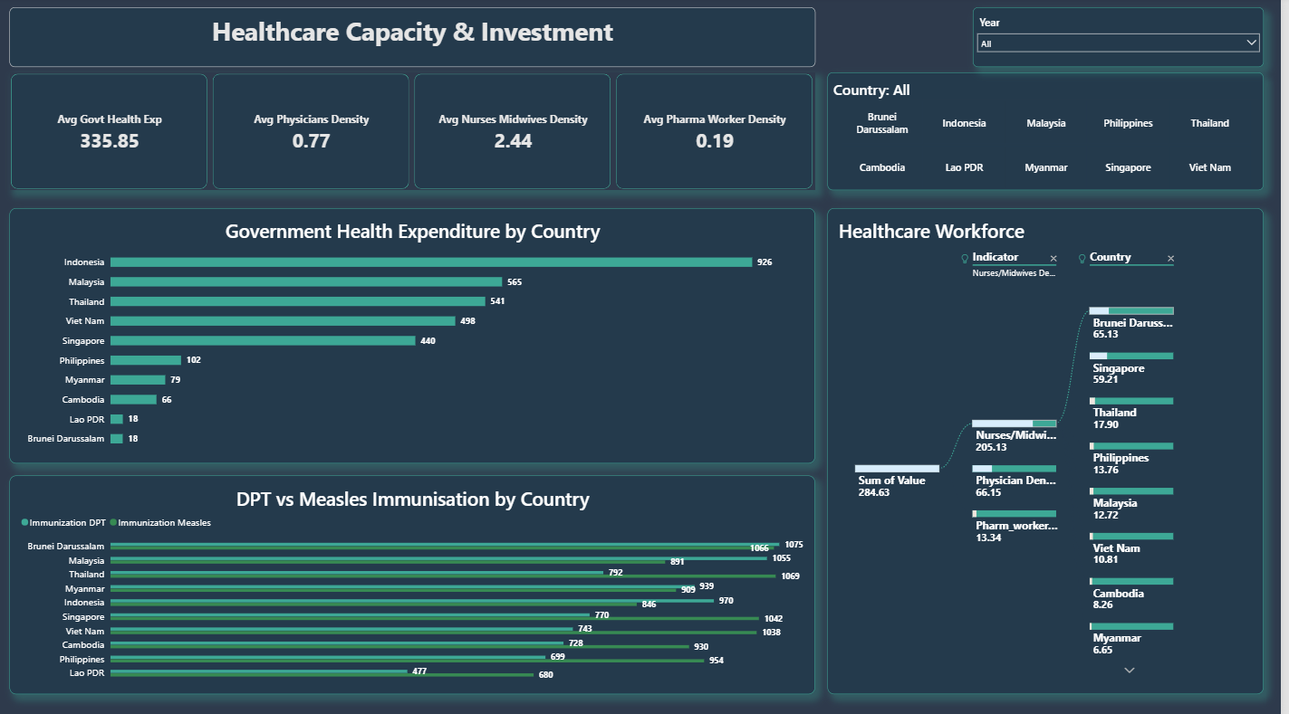

Slide 10
Dashboard Page 3: Capacity & Investment
10Alytics Global Hackathon 2026
This page links health outcomes to healthcare financing, workforce and prevention capacity.
Government Health Expenditure
Investment capacity and infrastructure readiness
• Which countries invest more or less in healthcare?
• Which countries have lower workforce density?
• How strong is immunisation coverage across countries?
• Where could limited capacity weaken public health response?
Physician Density
Medical workforce availability
Nurses/Midwives Density
Maternal, child and community care capacity
Emerging insight
Healthcare investment and workforce capacity vary across ASEAN countries. This may affect disease response, maternal care, child health support and access to essential services.
DPT & Measles Immunisation
Preventive healthcare coverage
ADHCRI Health Intelligence Dashboard | 8

Slide 11
Key Findings
10Alytics Global Hackathon 2026
The analysis points to unequal outcomes, disease burden and investment capacity across the region.
Funding gap
Child health inequality
Indonesia recorded the highest government health expenditure, while Brunei Darussalam recorded the lowest in the analysed data.
Lao PDR recorded the highest under-5 mortality rate, while Singapore recorded the lowest.
Disease burden concentration
Life expectancy progress
TB and malaria prevalence are concentrated in selected countries, showing the need for targeted surveillance.
Life expectancy improved across the analysed period, but country-level gaps remain visible.
ADHCRI Health Intelligence Dashboard | 9

Slide 12
Recommendations & SDG Impact
10Alytics Global Hackathon 2026
Practical actions for policymakers and development partners.
Recommendations
SDG alignment
• Prioritise child and maternal health investment in high-risk countries.
• Strengthen TB, malaria and HIV surveillance using routine data dashboards.
• Improve immunisation coverage and nutrition support for children under five.
• Increase healthcare workforce capacity where density is low.
• Use ASEAN-wide data collaboration to track SDG 3 progress consistently.
SDG 3
Tracks mortality, disease burden, immunisation, nutrition and workforce indicators.
SDG 10
Highlights inequality in health outcomes and health system capacity.
SDG 17
Supports regional data partnerships and evidence-based public health planning.
ADHCRI Health Intelligence Dashboard | 10

Slide 13
ADHCRI Health Intelligence Dashboard
A 10Alytics Global Hackathon 2026 project using analytics to highlight health risks, inequalities and priority areas for action across ASEAN.
Good Health & Well-being
Reduced Inequalities
Partnerships for the Goals
Thank You

